Slide 1
Predicting Solar Energy Generation using Time Series and Machine Learning Models
Ayse B Sengul, PhD
Springboard Data Science Capstone Project
July 16, 2024

Slide 2
Problem Statement
Challenge: Variability in environmental factors such as solar irradiance, temperature, and weather conditions makes accurate solar energy prediction difficult.
Importance:
Efficient grid operation.
Economic benefits (1.56% reduction in general costs - $ 46.5 million).
Environmental impacts (32% reduction in CO₂ emissions).
Develop and evaluate advanced time series and machine learning models to improve the accuracy of solar energy generation prediction.

Slide 3
Flowchart of the Solar Energy Generation Prediction
Solar Power
Generation Data
Data Wrangling
EDA
Pre-Processing
Data Collection
Distribution Analysis
Data Splitting
Data Cleaning
Outlier Detection
80:20
Feature Engineering
Correlation Analysis
Feature Scaling
Data Merging
Time Series Analysis
Log Transformation + StandarScaler
Model Evaluation
Modeling
Best Performing Model
Model Selection
Hyperparameter Tuning
Cross Validation
RMSE
MAPE
Sarima, RF, XGBoost
Sarima, RF, XGBoost
3 – 5 – 7 – 10 fold
RF: Random Forest, RMSE: root mean squared error, MAPE: mean absolute percentage error

Slide 4
Data Overview
Source:
Solar Power Plant Data (Generation and Weather data)
15 min intervals over 34 days.
May 15 – June 17, 2020.
Size:
The generation data – (67698, 7)
The weather data – (3259, 6).
Key Features:
'DATE_TIME’, 'AC_POWER', 'AMBIENT_TEMPERATURE’, 'MODULE_TEMPERATURE', 'IRRADIATION

Slide 5
Data Wrangling
Converted 'DATE_TIME' to datetime.
Extracted 'DATE', 'TIME', 'MONTH', 'HOURS', and 'MINUTES'.
Dropped redundant columns ('PLANT_ID' and 'SOURCE_KEY').
Merged datasets on 'DATE_TIME'.
Converted categorical 'SOURCE_KEY' to numerical 'INVERTER' and dropped the original 'SOURCE_KEY'.

Slide 6
Exploratory Data Analysis (EDA)
Histograms and KDE Plots: Visualized numerical column distributions.
Box Plots: Identified outliers.
Pair Plots and Correlation Matrix Heatmap: Explored numerical feature relationships.
Time Series Plots: Analyzed trends for AC_POWER, IRRADIATION, and MODULE_TEMPERATURE.
Daily Analysis Plots: Examined total AC_POWER generation, IRRADIATION, and MODULE_TEMPERATURE by date.
Efficiency Analysis Plots: Assessed inverter efficiency and trends over time.

Slide 7
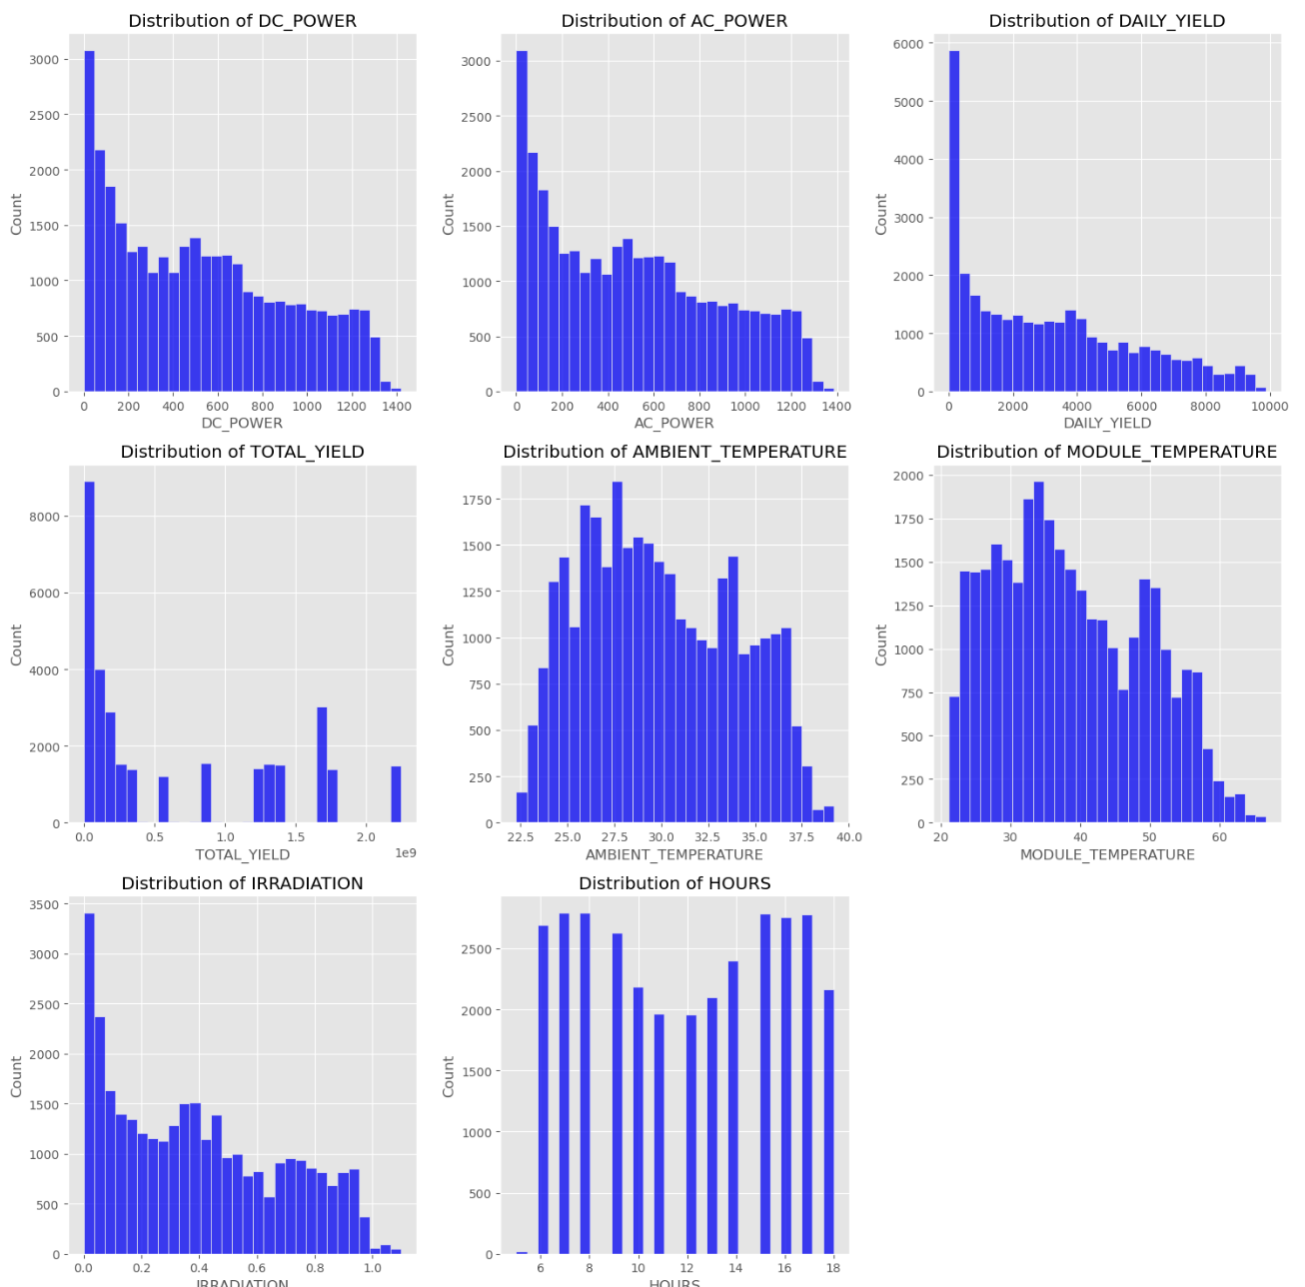
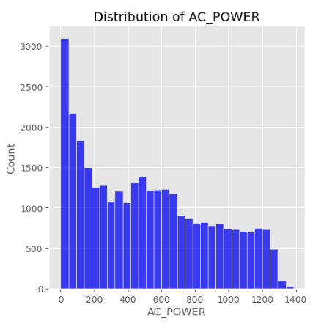
Exploratory Data Analysis (EDA)
AC_POWER
AC_POWER values spanned from 0.2 – 1420 kW.
Most data btw 400 – 600 kW.
Mean value of AC_POWER – 521 kW.
Figure 1. Distribution of numerical columns after filtering out zero values.

Slide 8
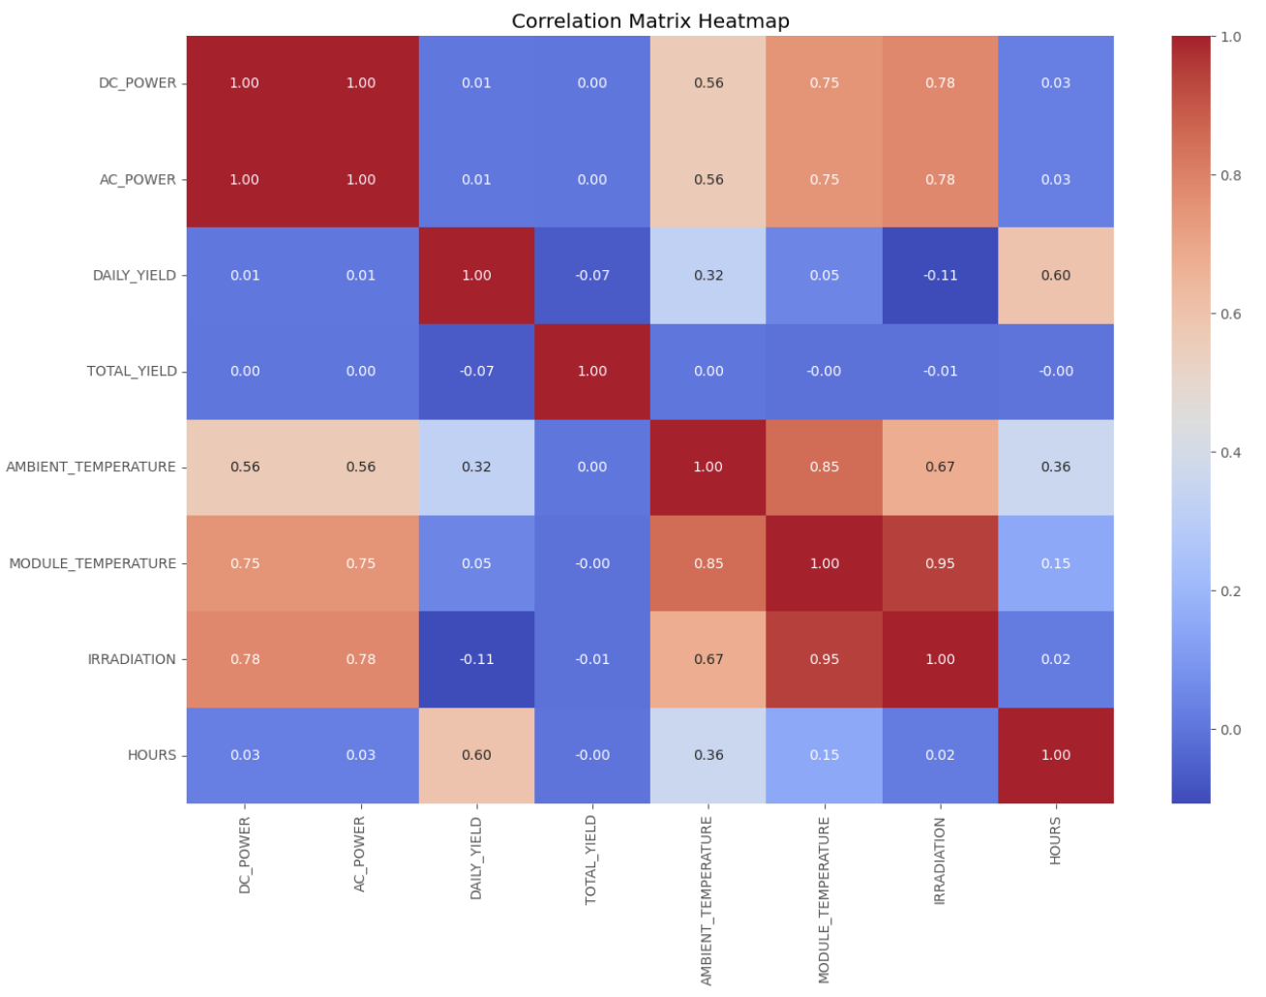
Exploratory Data Analysis (EDA)
AC_POWER has a very strong positive correlation with DC_POWER , a high positive correlation with IRRADIATION and, MODULE_TEMPERATURE, and moderate correlation with AMBIENT_TEMPERATURE.
Figure 2. Correlation Heatmap of Numerical Features.

Slide 9
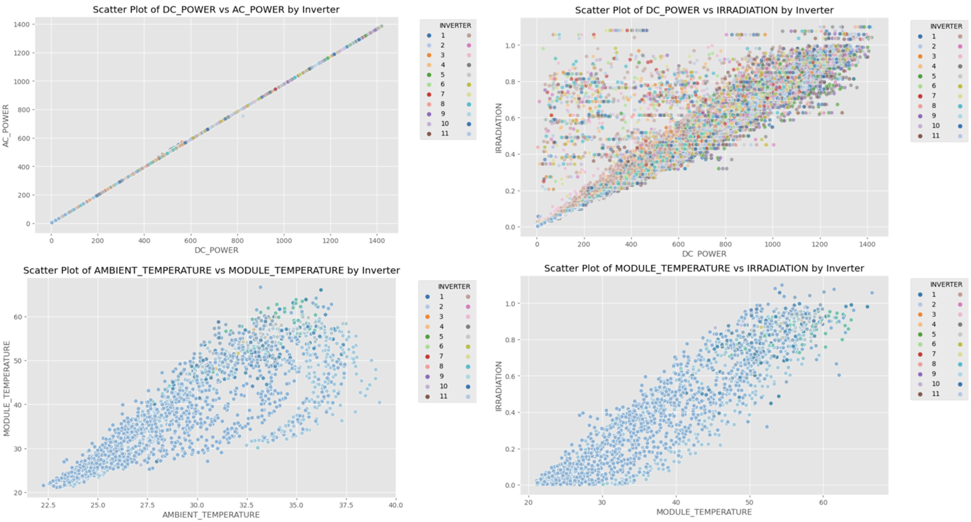
Exploratory Data Analysis (EDA)
Figure 3. Scatter plot of strongly correlated features.

Slide 10
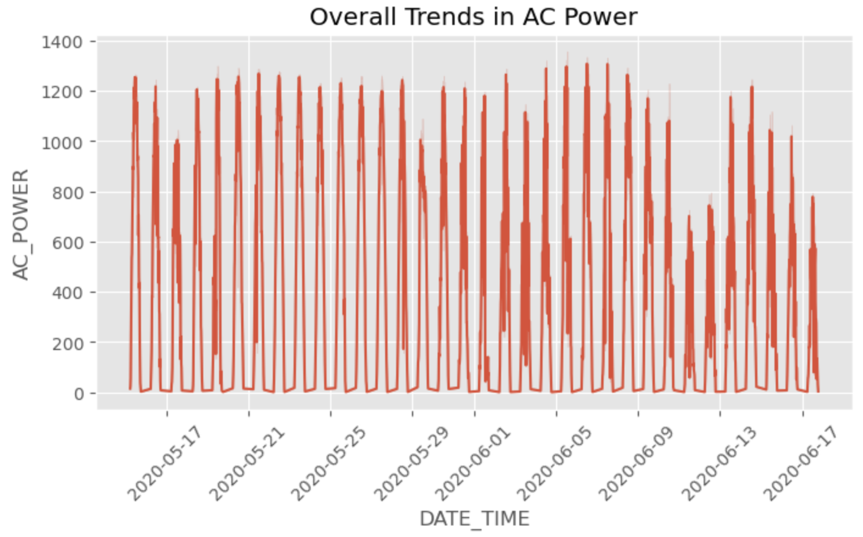
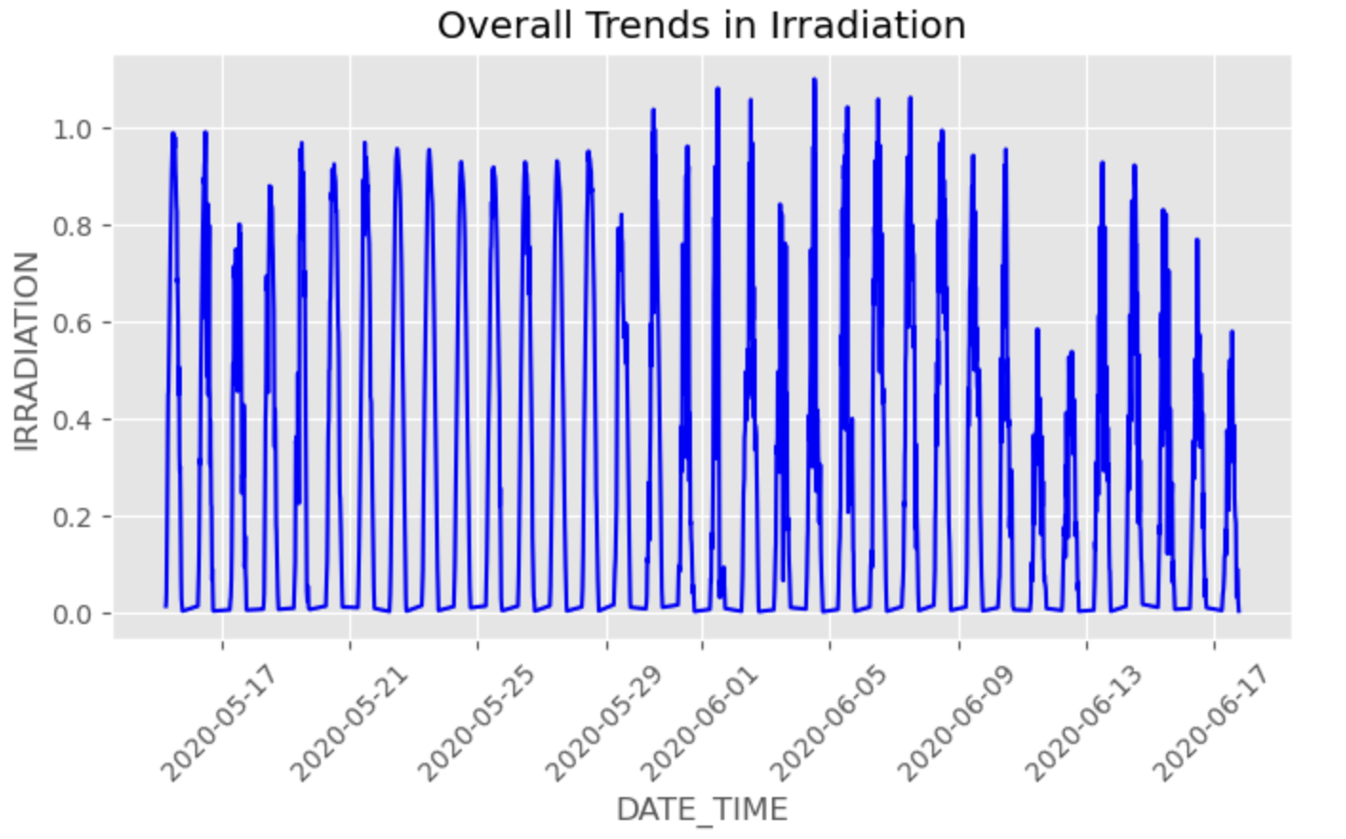
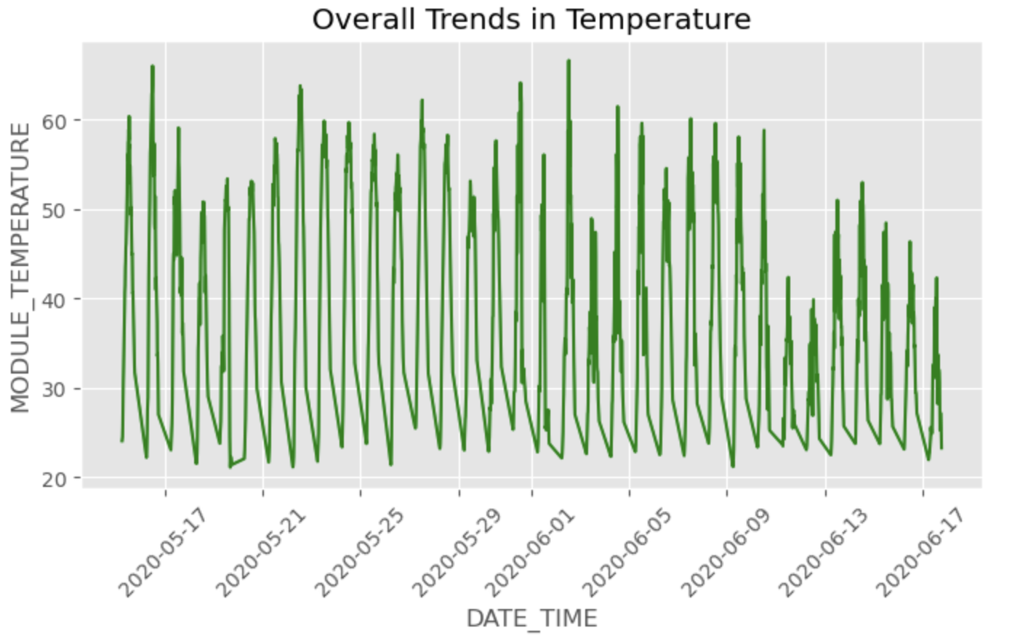
Exploratory Data Analysis (EDA)
a)
b)
c)
Figure 4. Time trend in a) AC_POWER, b) IRRADIATION, and c) MODULE_TEMPERATURE.

Slide 11
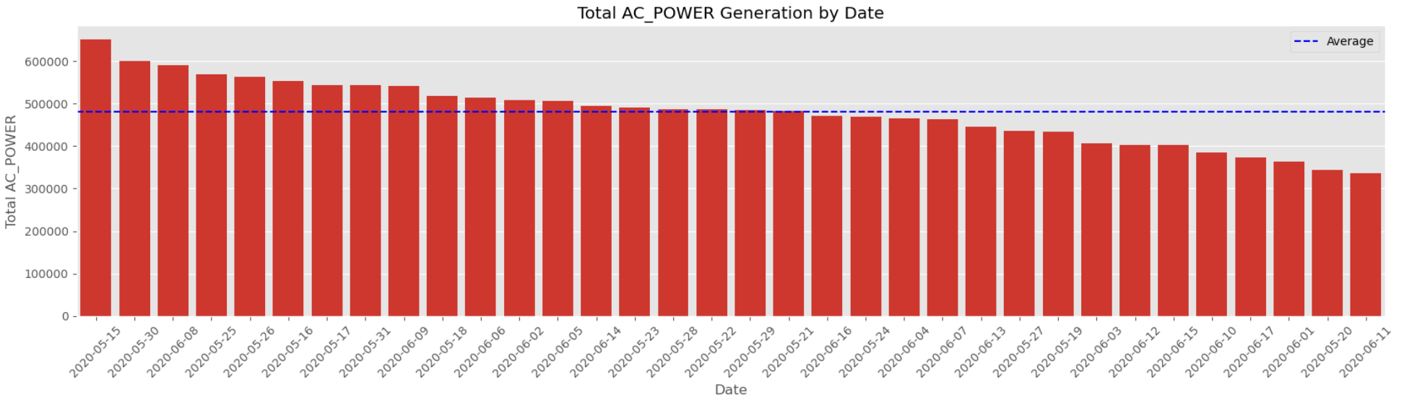
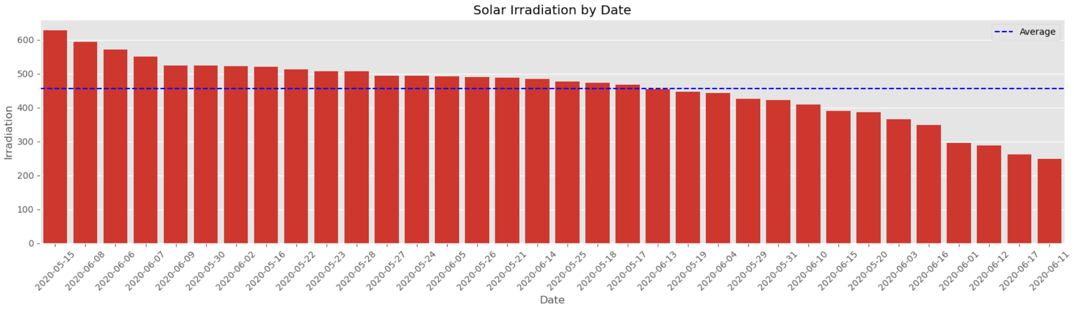
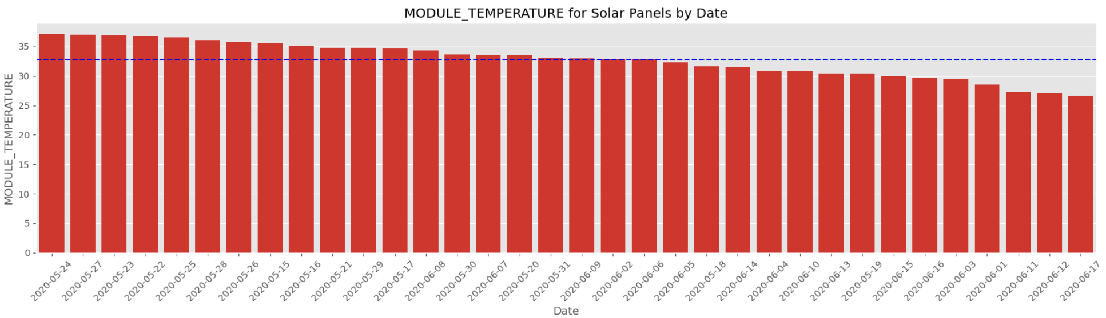
Exploratory Data Analysis (EDA)
a)
Highest: May 15
Lowest: June 11
b)
Highest: May 15
Lowest: June 11
c)
Highest: May 24 Lowest: June 17
Figure 5. a) AC_POWER generation, b) Solar IRRADIATION and c) MODULE_TEMPERATURE by date.

Slide 12
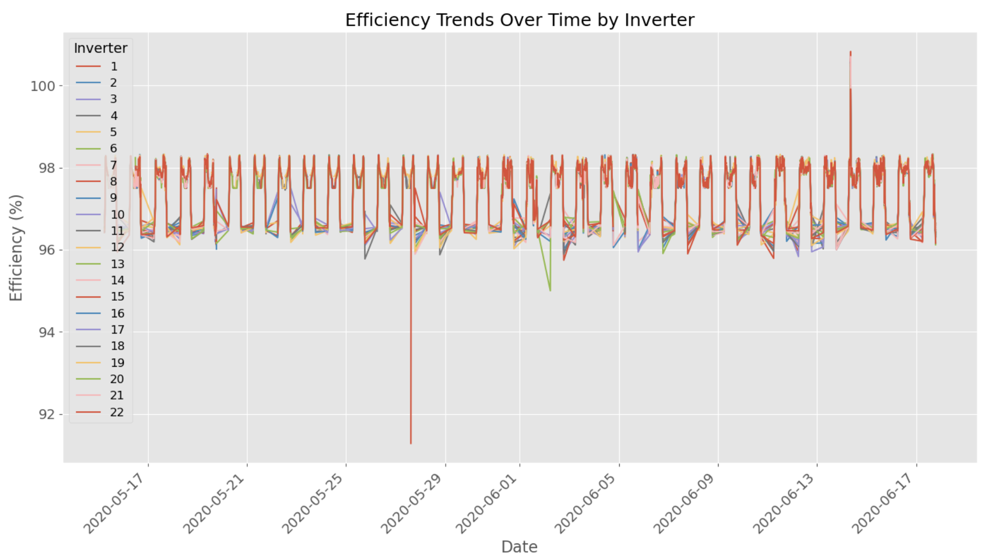
Exploratory Data Analysis (EDA)
Average efficiency : 97%
Figure 6. Efficiency Trends over Time.

Slide 13
Pre-Processing
Converted 'DATE_TIME' to datetime and set as index.
Applied sine and cosine transformations to 'HOURS' and 'MINUTES' .
Dropped redundant columns ('DATE', 'TIME', 'HOURS', 'MINUTES’).
Aggregated data by taking the mean of selected columns per timestamp.
Resampled data to 15-minute intervals
Interpolated missing values .

Slide 14
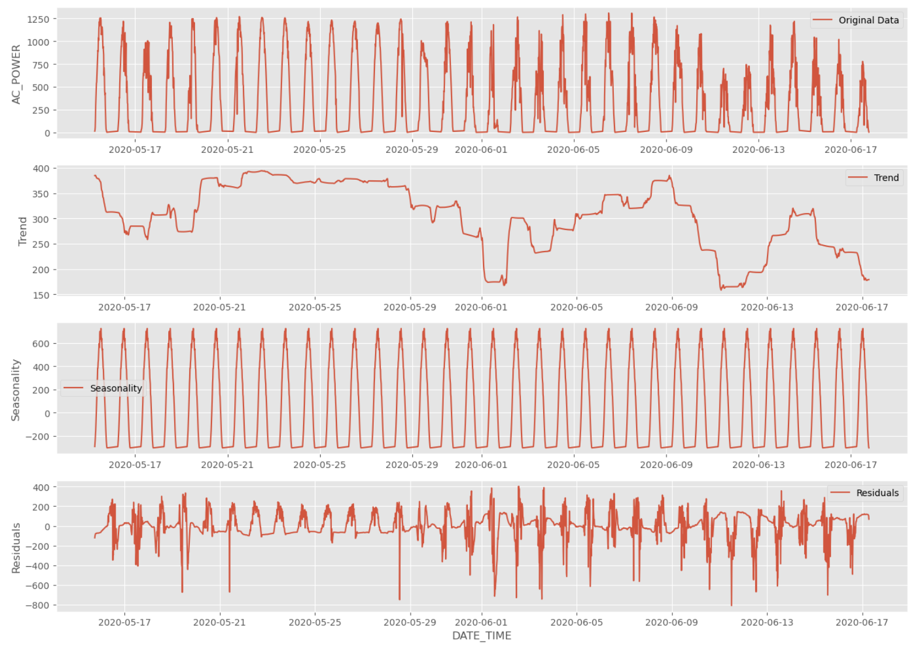
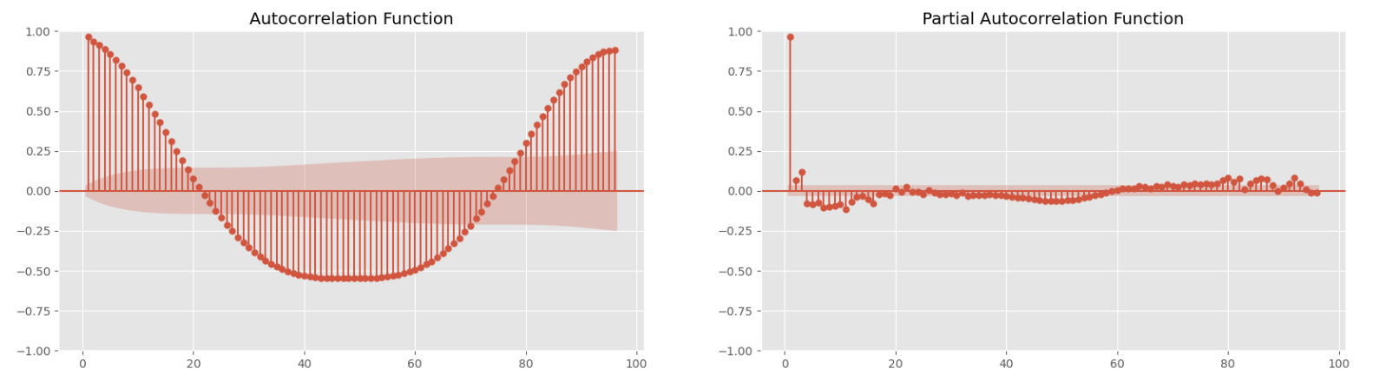
Pre-Processing
Figure 7. Decomposition of time series data.
Figure 8. ACF and PACF plot.

Slide 15
Modeling
Models: SARIMA, Random Forest, XGBoost
Evaluation metrics: RMSE, MAPE.
Data splitting: 80-20 ratio
Feature scaling: Log transformation and StandardScaler
Hyperparameter tuning: Grid Searhing
SARIMA: p, d, q ( range of 0 to 2)
Random Forest: 'n_estimators': [100, 200, 300], 'max_depth': [None, 10, 20], 'min_samples_split': [2, 5, 10], 'min_samples_leaf': [1, 2, 4], 'max_features': ['sqrt', 'log2']
XGBoost: 'n_estimators': [100, 200, 300], 'max_depth': [3, 5, 7], 'learning_rate': [0.01, 0.05, 0.1]
Cross-validation: 3-fold, 5-fold, 7-fold, 10-fold.

Slide 16
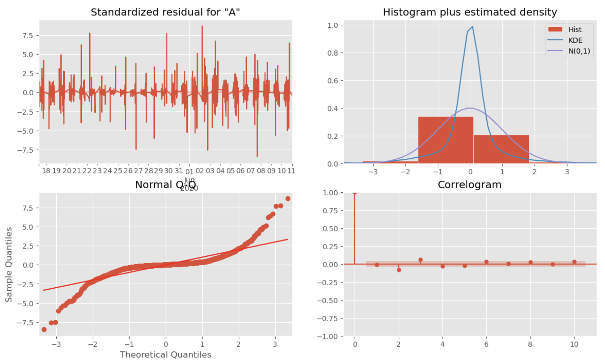
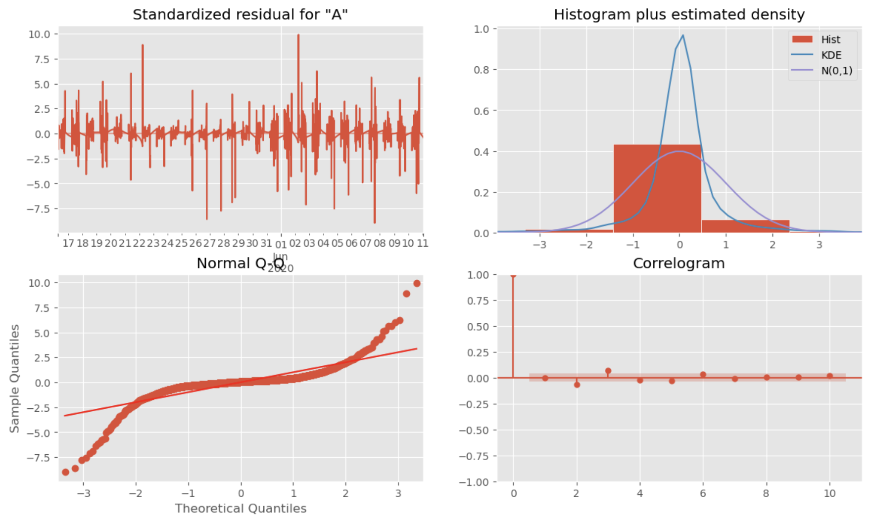
Modeling – SARIMA
Initial Sarima
order=(1, 0, 0) seasonal_order=(1, 1, 0, 96)
Tuned Sarima
order=(1, 1, 1) seasonal_order=(1, 1, 0, 96)
a
b
Figure 9. The diagnostic plots of the a) initial and b) tuned SARIMA model.

Slide 17
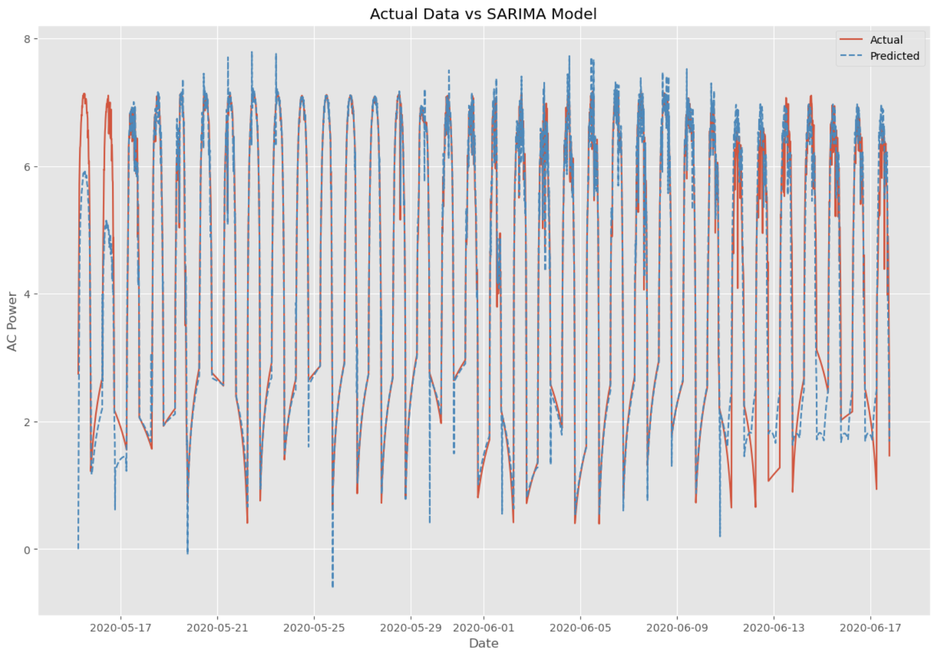
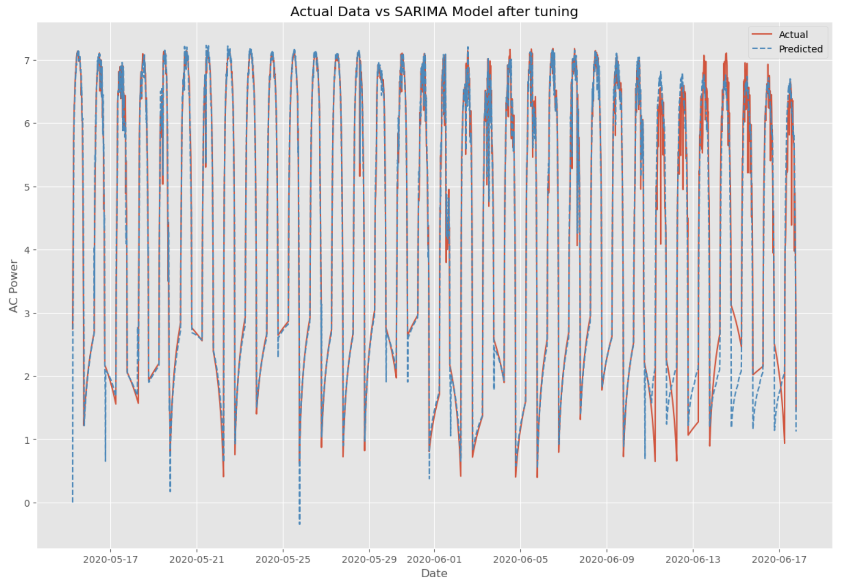
Modeling – SARIMA
Initial Sarima
order=(1, 0, 0) seasonal_order=(1, 1, 0, 96)
Tuned Sarima
order=(1, 1, 1) seasonal_order=(1, 1, 0, 96)
a
b
RMSE = 0.700
MAPE = 23.382%
RMSE = 0.608
MAPE = 20.570%
Figure 10. Actual vs. predicted values for the a) initial and b) tuned SARIMA model.

Slide 18
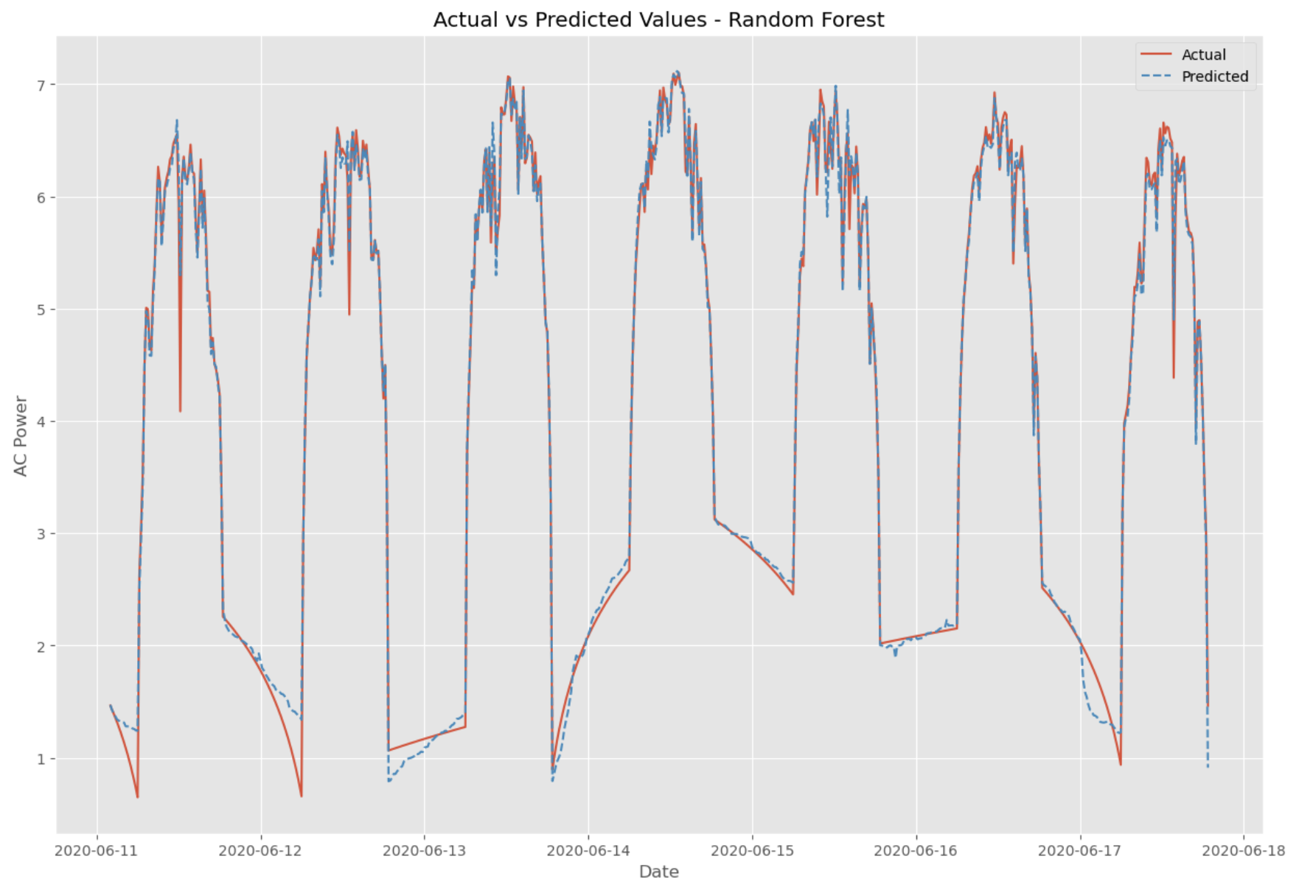
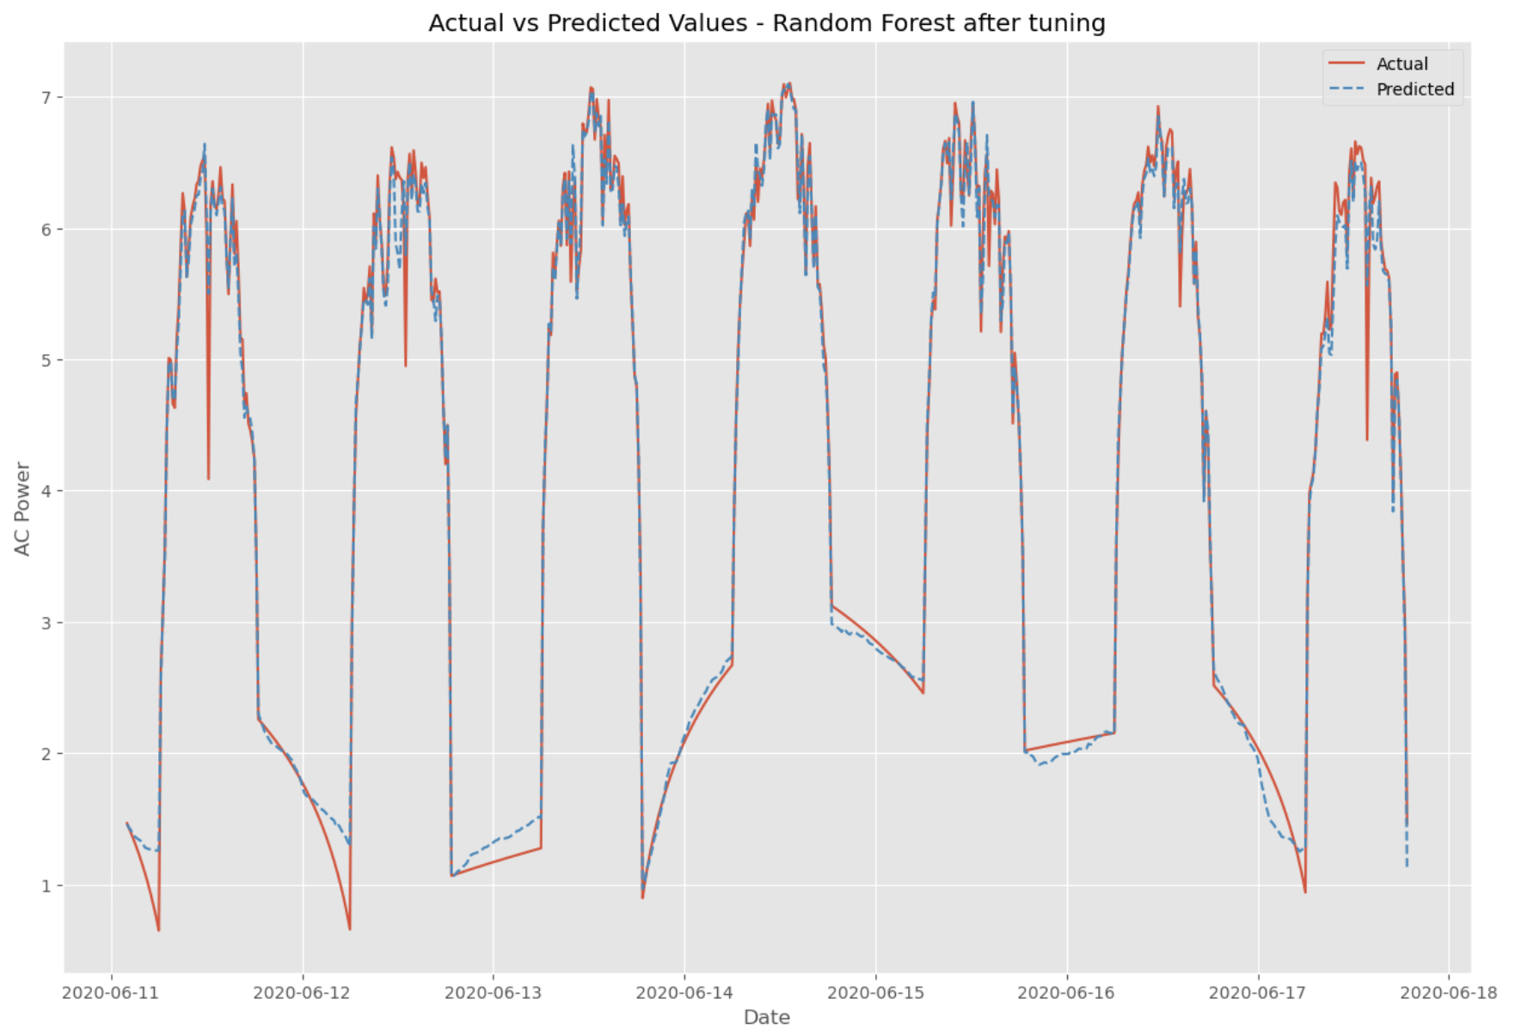
Modeling – Random Forest
a
b
RMSE = 0.143
MAPE = 4.387%
RMSE = 0.165
MAPE = 4.653%
Figure 11. Actual vs. predicted values for the a) initial and b) tuned Random Forest model.

Slide 19
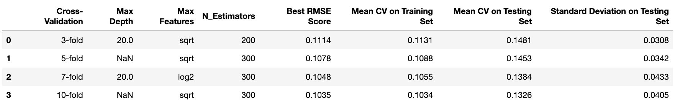
Modeling – Random Forest
Table 1. Random Forest Model Cross-Validation Results.

Slide 20
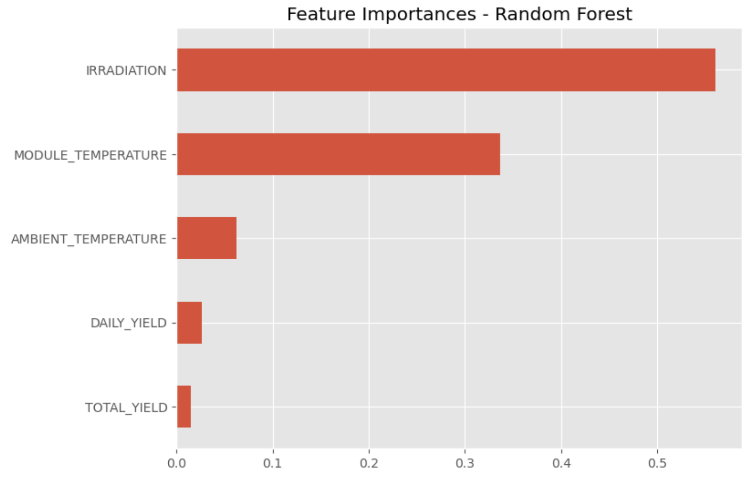
Modeling – Random Forest
Figure 12. Feature importance of the Random Forest model.

Slide 21
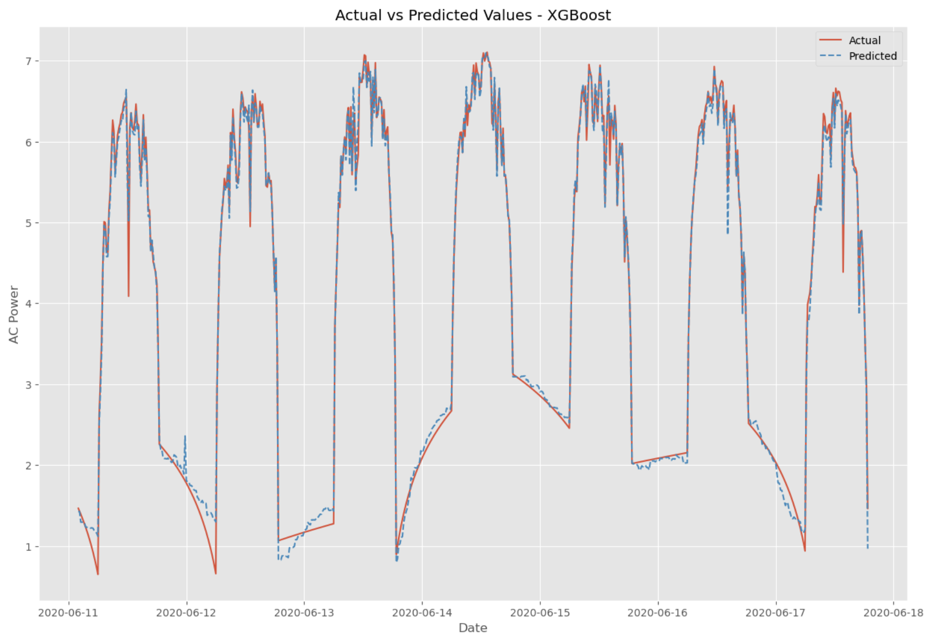
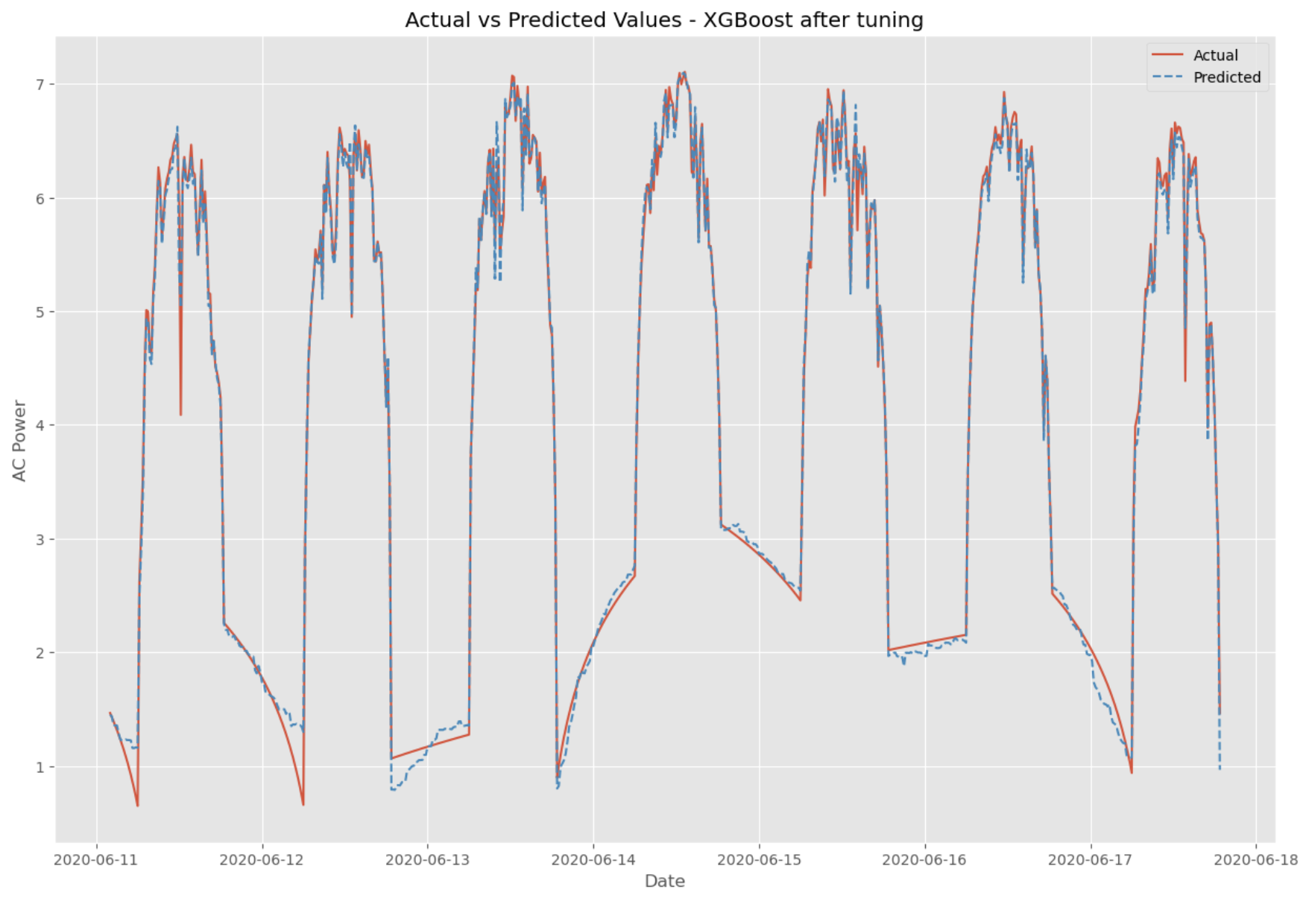
Modeling – XGBoost
a
b
RMSE = 0.135
MAPE = 4.455%
RMSE = 0.125
MAPE = 4.065%
Figure 13. Actual vs. predicted values for the a) initial and b) tuned XGBoost model.

Slide 22
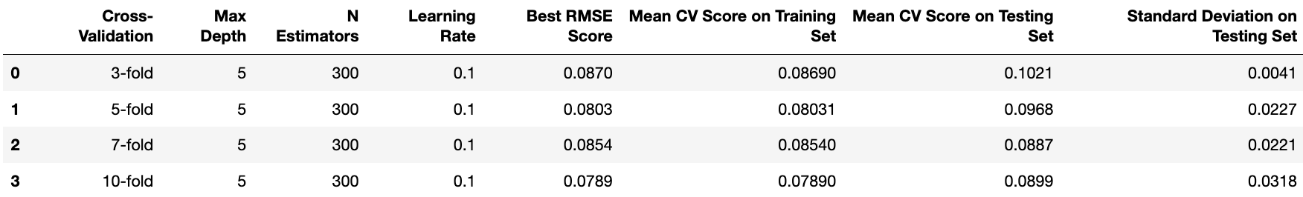
Modeling – XGBoost
Table 2. XGBoost Model Cross-Validation Results.

Slide 23
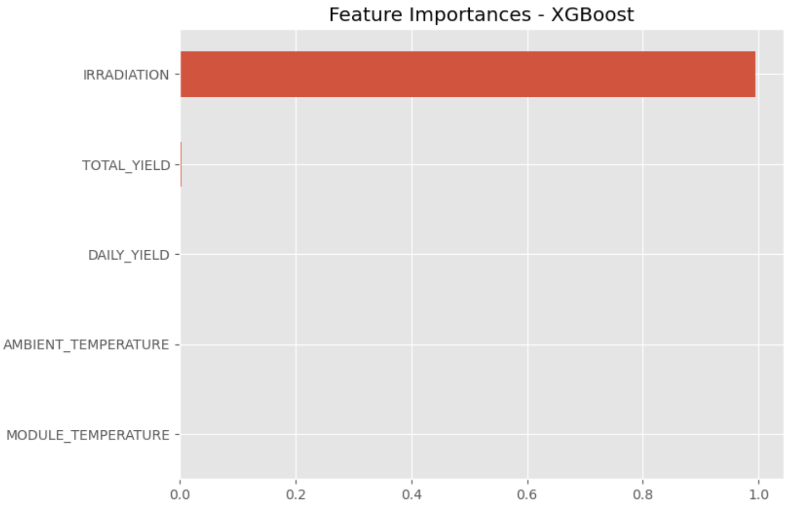
Modeling – XGBoost
Figure 14. Feature importance of the XGBoost model.

Slide 24
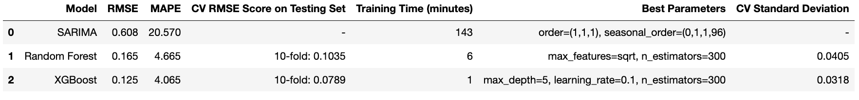
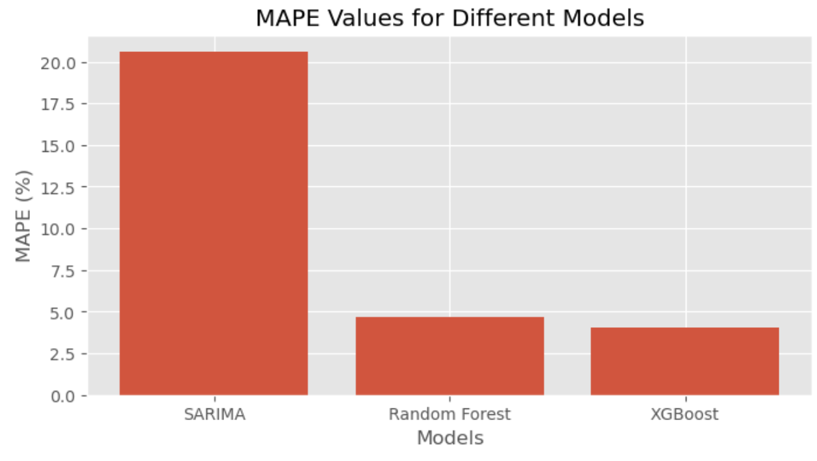
Results
Table 3. Comparison of models.
Figure 15. Comparison of MAPE values for different models.

Slide 25
Conclusion
Best Model: XGBoost (Lowest RMSE: 0.125, MAPE: 4.065%)
Efficiency: XGBoost (1 minute training time)
Random Forest: Good performance, slight overfitting
SARIMA: Least effective, high RMSE and MAPE, long training time

Slide 26
Future Work
Incorporate additional environmental factors (humidity, wind speed, cloud cover) to improve model accuracy.
Enhance feature engineering techniques (cyclical features, lag features, rolling statistics).
Explore alternative time series models like Prophet for better performance.
Investigate deep learning models such as LSTM networks for time series forecasting.

Slide 27

Questions?

